Slide 1
ADVANCE™ TERMITE BAIT SYSTEM
Termite Data Summary
Review
August 2004

Slide 2
Data Review Outline
Colony Elimination – University Validation
System Component Validation
Formosan Termite Efficacy Data
Key Learning's – University and Marketplace

Slide 3
ADVANCE TERMITE BAIT SYSTEM
Colony Elimination
Field Research
University of Georgia

Slide 4
Dr. Brian Forschler
University of Georgia
Research program:
  Principal Investigator for the Household and Structural Entomology research program
  Research program includes the biology and control of subterranean termites and Argentine ants
  Recent studies include:
    Estimations of termite colony territory size
    Termite foraging populations and wood consumption rates for three subterranean termite species in the field
    Termite acceptance of potential artificial bait substrates

Slide 5
ATBS Efficacy Study
Field Research Objectives
Demonstrate system efficacy in high pressure termite environments
  Select buildings with several years of termite monitoring history and multiple colonies (where possible)
Demonstrate termite feeding on Termite Inspection Cartridge and Termite Bait Cartridge as proof of matrix and bait palatability

Slide 6
ATBS Efficacy Study
Field Research Objectives
Demonstrate the transfer of Diflubenzuron amongst colony members leading to colony elimination
  Demonstrate effectiveness of Diflubenzuron against multiple colonies feeding at a single building site

Slide 7
ATBS Efficacy Study
Field Research Objectives
Prove conclusively through DNA mapping that Diflubenzuron can eliminate termite colonies
  DNA mapping of termite samples taken during trial

Slide 8
Non-Scientific Definition of Colony Elimination?
Label definition for “Termite Colony Elimination”
  90 days with no termites feeding after last bait tube introduced

Slide 9
Methods for Termite Colony Determination
Triple-mark-recapture
  Based on current research knowledge size of termite colony can be greatly exaggerated
Cuticular Hydrocarbon
  Useful for determining species, but not termites of same species, different colonies
Antagonism
  May provide false relation of two different termite colonies

Slide 10
Methods for Termite Colony Determination
DNA
  Genetic markers
    Most research using genetic markers obtain sample from a combined genetic pool of several termites
  Mitochondrial DNA
    Sample obtained from single termite
    Multiple samples from single collection site defines colony and possible association or overlap between colonies
    Most definitive

Slide 11
Scientific Evidence of Colony Elimination?
DNA colony mapping:
  DNA confirmation of maternal lines present before and during study
  Comprehensive determination of termite elimination
  1 year with no termite activity after final reported bait consumption

Slide 12
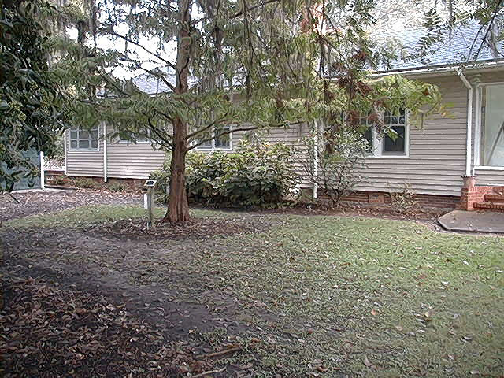
Field Site - Colony Elimination
Site: Bamboo Experiment Station, Savannah GA Station Office (4 years termite history)

Slide 13
Bamboo Office
Site Statistics: Installed 7/02 (last update August 2004)
Unique station hits: 6 of 9 stations (67%)
First station(s) hit August 2002
Total grams of bait consumed = 244 g
Number of termite colonies identified = 1 (ML3)
  Maternal line identified as the same colony infesting Bamboo Shop building.
Last report of bait consumption – November, 2003.
March 2004 update, Dr. Forschler – data indicates elimination of ML3 (maternal line 3) colony
Notes:
Station hits were fast, only 30 days after installation
Six unique station hits proves attractiveness of station to termite and termite feeding
Last termite activity reported was 8 months past, based on past termite history and pressure colony has been reported as eliminated by Dr. Brian Forschler

Slide 14
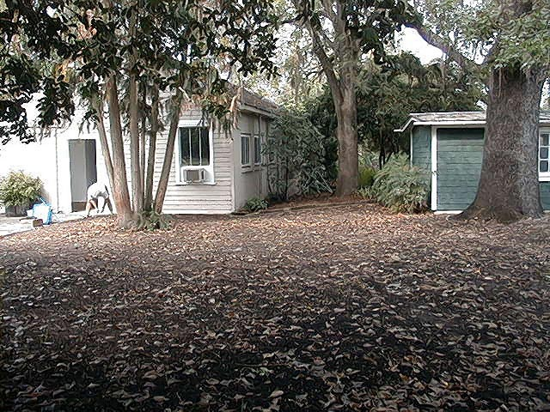
Field Site - Colony Elimination
Site: Bamboo Experiment Station, Savannah GA – Shop (4 years termite history)

Slide 15
Bamboo Shop
Site Statistics: Install 7/02 (last update August 2004)
Unique station hits: 5 of 22 stations (23%)
First station(s) hit – August 2002
Total grams of bait consumed = 512 g
Number of termite colonies identified = 2 (ML3 & 10)
Last report of bait consumption – May, 2003
ML3 same maternal line found infesting station office site
March 2004 update, Forschler – data indicates elimination of ML10 and in conjunction with station office site, elimination of ML3
Notes:
Fast hits continue at this site with 5 stations hit within 30 days of placing stations in the ground.
Two termite colonies feeding at this site.
Last bait consumption reported in May of 2003, last report July 2004 with no termite activity.
Colony elimination achieved.
Colony ML3 covers a larger area and infested the office building as well, both sites now eliminated.

Slide 16
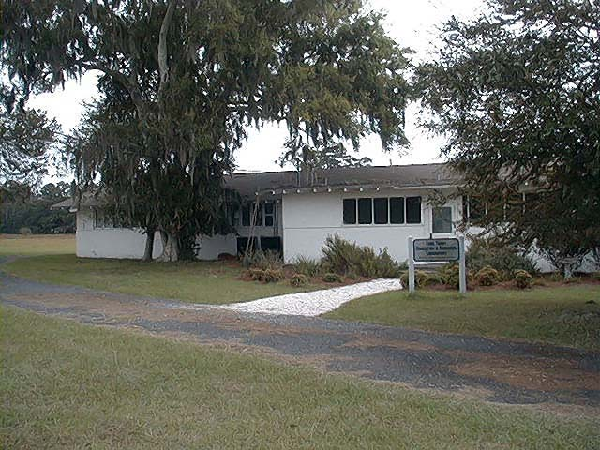
Field Site - Colony Elimination
Site: Sapelo Island, GA - Aquatics Laboratory
(4 years termite history)

Slide 17
Aquatics Lab
Site Statistics: Install 7/02 (last update August 2004)
Unique station hits: 6 of 25 stations (24%)
First station(s) hit – August 2002
Total grams of bait consumed = 406 g
Number of termite colonies identified = 5 ML (3/04)
Last report of bait consumption – May, 2003
March 2004 update, Dr. Forschler – data indicates elimination of MLs #1, 2, and 5
March 2004 update – ML 3 & 4 appeared 9/03 and consumed less than 1 gram total and have not been reported again - through 8/04
Notes:
Sapelo Island site with several years termite population monitoring.
Fast station hits, within 30 days of install.
5 termite colonies feeding at this site, two colonies fed briefly (ML3&4) and have not been seen since.
No termite bait consumption reported for more than 12 months.
Termites eliminated from this site.

Slide 18
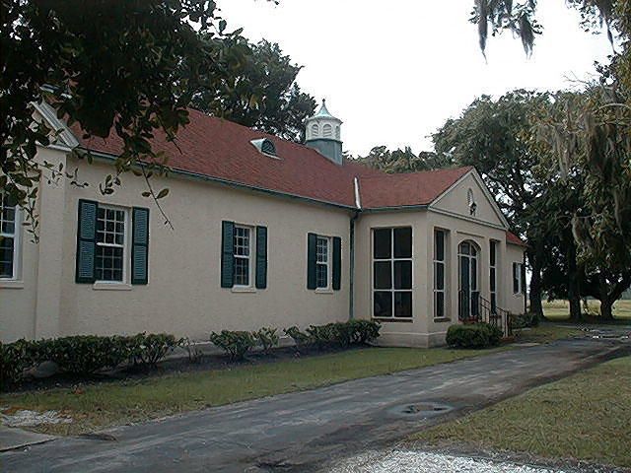
Field Site - Colony Elimination
Site: Sapelo Island, GA – Breezeway
(9 years termite history)

Slide 19
Breezeway #2
Site Statistics: Install 7/02 (last update August 2004)
Unique station hits: 8 of 23 stations (35%)
First station(s) hit – August 2002
Total grams of bait consumed = 255 g
Number of termite colonies identified = 4 ML (May 2004)
  a) Three stations yet to have ML identified
Last report of termites in stations – April, 2003
Last report of bait consumption – May, 2003
Last update reported – August, 2004
Notes:
Fast station hits, within 30 days of install.
Four termite colonies feeding at this site.
Last report of bait consumption in May of 2003 with no termite activity reported since.
Over 12 months of control.
Four termite colonies eliminated.

Slide 20
Thank You

